Slide 1
Loc Genie -GPU License V2
Srividya Sundaram srividya@pdx.edu

Slide 2
For whom?
For any travel savvy person who would love to explore his local area more and learn about places of his favorite activity.
Enables users to pick an activity of their choice from a set of activities (Hiking, Camping, Fishing, Bowling etc) and allows them to input a distance within which they would like to explore.
Places are suggested along with their address and based on their prominence in a Map View.
Also dynamically displays places of chosen activity within the visible region of the map, whenever users drag the map away from their current location.

Slide 3
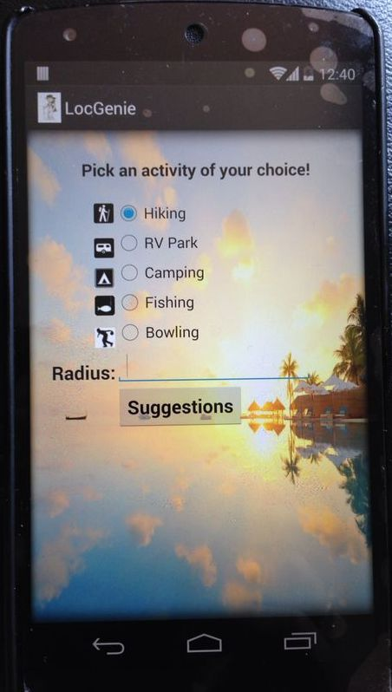
Main Screen

Slide 4
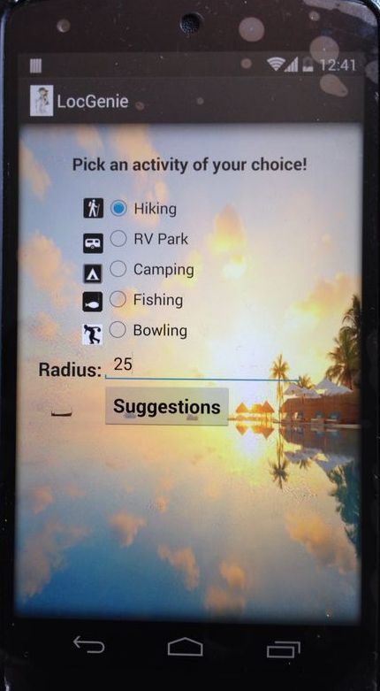

Slide 5
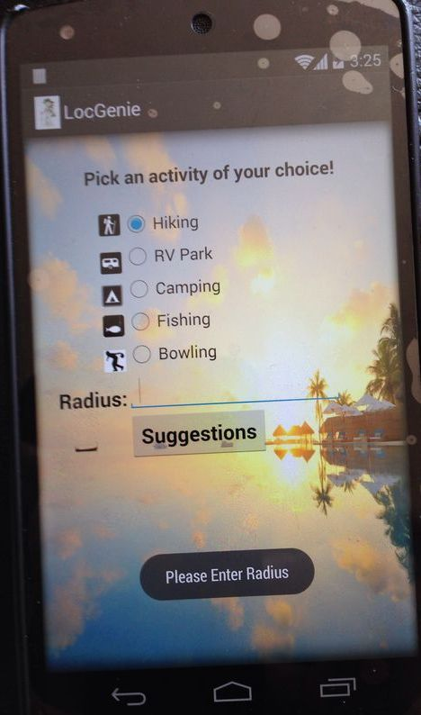

Slide 6
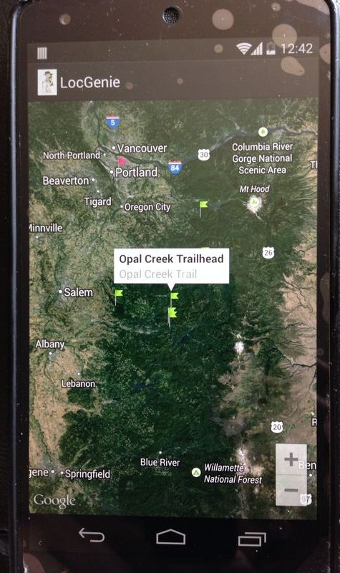

Slide 7
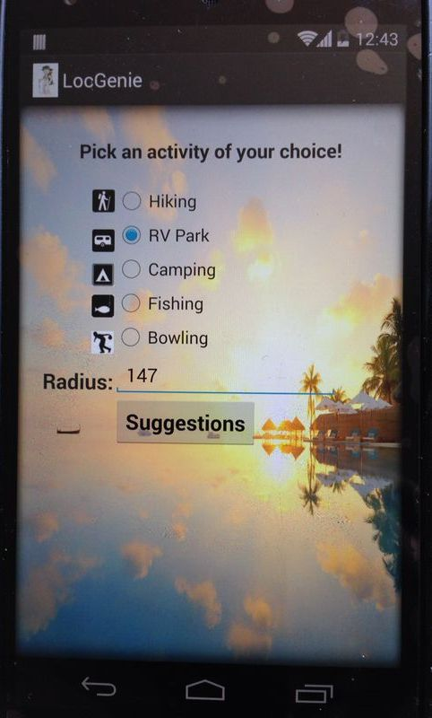

Slide 8
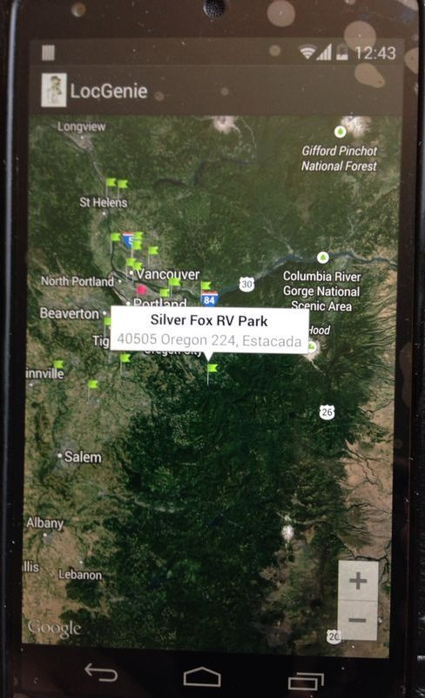

Slide 9
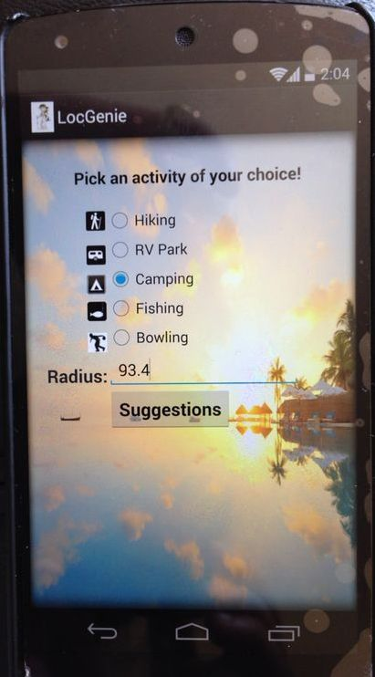

Slide 10
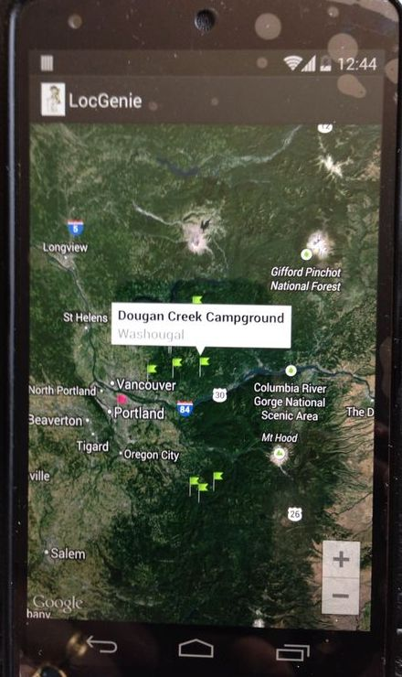

Slide 11
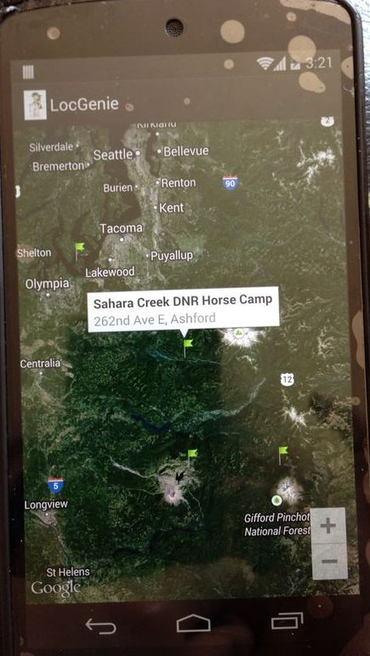

Slide 12
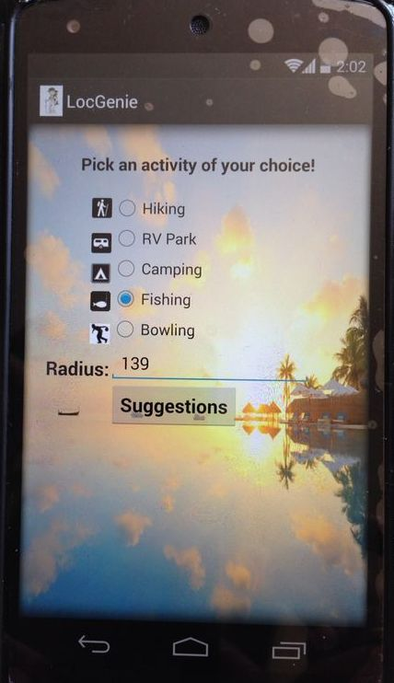

Slide 13
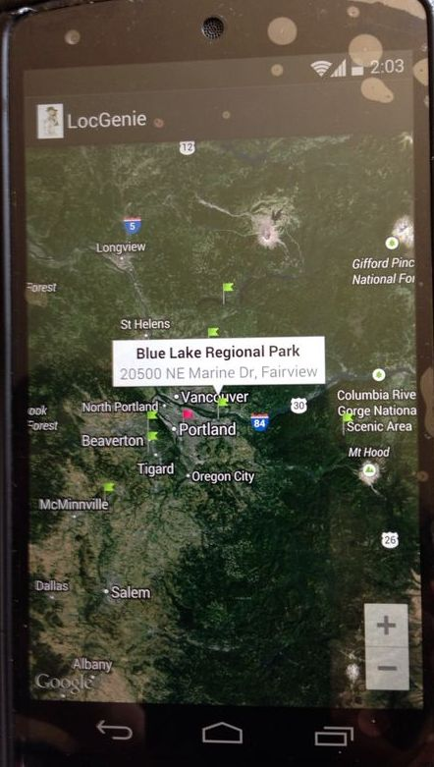

Slide 14
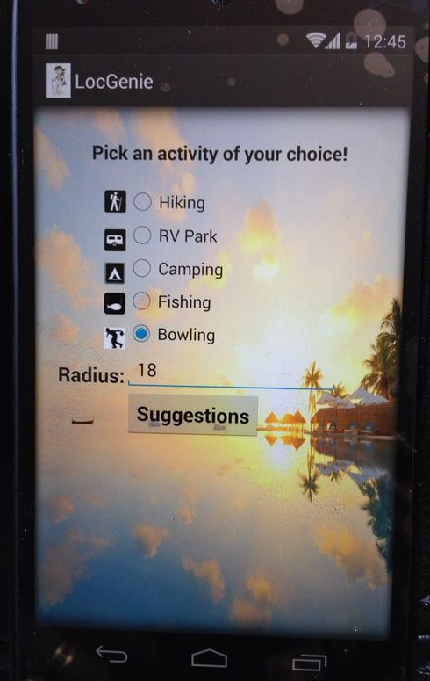

Slide 15
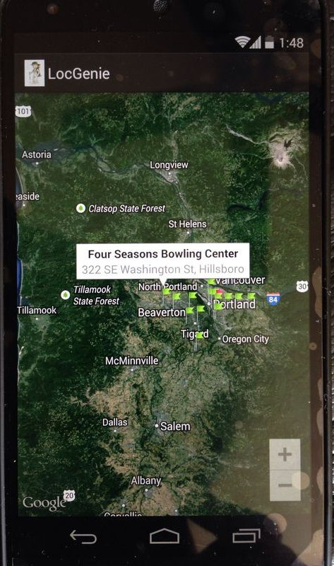

Slide 16
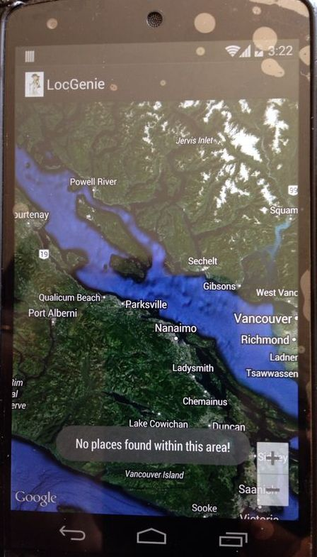

Slide 17
Pre-requisites
Internet Connection.
Android device.
Google Play Services installed in the android device.
Your own Google Places API Key and Google Maps API Key generated from your Google account.

Slide 18
Other Options
Users might google for places of their preferred activity.
Loc Genie instead gives them an option to just select their choice of activity and preferred distance and displays suggestions based on their prominence ie. global popularity, place’s ranking in Google’s index, number of check-ins etc.
Also it dynamically displays places whenever the user drags the Map and navigate to a different location.
When the user navigates to a different region in the Map, the center of the Map is considered as the base location.
The visible region of the Map is considered as the bounding rectangle and places within this region are displayed to the user.

Slide 19
Lessons learnt
In order to capture user drag start and drag end movement, I had initially used onCameraChangeListener.
However, it was getting called every time the map moves/zooms in/out or the camera angle changes.
To overcome this, I created a wrapper class that captured users touch by means of MotionEvent.ACTION_DOWN and MotionEvent.ACTION_UP.

Slide 20
Lessons learnt cont..
As Google Maps requires Google Play services to be installed, the application could not be run on an emulator and could be tested only on an actual device.
Also learnt that the usage limit for accessing Google Places API and Google Maps API should be kept under check.
The per day usage limit for a free user is 1000 hits.
https://developers.google.com/places/usage

Slide 21
Future Enhancements
Add more activities that can be chosen.(rafting, parasailing etc)
Calculate distance from users current location to the suggested places.
Predict climatic conditions of those places on the current day and suggest the best place to visit among all the places suggested.
Suggest nearby eat outs along with the places.

Slide 22
Thank You !
Questions ?

